Slide 1
Systematic Testing of Distributed Systems
Burcu Kulahcioglu Ozkan
Concurrency Theory, 17/01/2020
TU Kaiserslautern

Slide 2
Distributed systems
A set of distributed computers that coordinate and cooperate for performing some task
Centralized data center
Distributed data center

Slide 3
Distributed systems
Advantages:
Scalability
Sharing
Communication
Reliability

Slide 4
Distributed systems
Challenges:
Concurrency
Asynchrony
Coordination
Replication
Fault-tolerance
Makes it hard to reason about possible executions

Slide 5
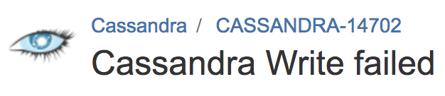

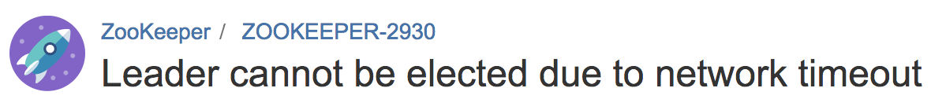
Distributed systems are prone to concurrency bugs!
Node 1
Node 2
. . .

Slide 6
A simple execution example
Handler
Logger
Terminator
Handler
Logger
Terminator
Request
Request
Log
Terminate
Terminate
Flush
Flush
Flushed
Flushed
Log
Buggy if:
Flush executes before Log!

Slide 7
A taxonomy of concurrency bugs in distributed systems*
* (Leesatapornwongsa et. al., ASPLOS 2016)

Slide 8
Let’s take a closer look at some bug patterns
Order violation
Atomicity violation
Fault at a specific timing
Reboot at a specific timing
Combination of multiple unexpected orderings/faults/reboots

Slide 9
How to detect bugs?
. . . . . . . . .
. . . . . . . .
. . . . . . . .
. . . . . . . . . . . . . . . . . . . . . . . . .
. . . . . . . .
. . . . . . . . . . .
. . . . . . . . . . .
Systematic testing - infeasible
Random testing (e.g. PCT, Jepsen)
Needs reduction techniques (e.g. SAMC, FlyMC)

Slide 10
Combining model checking and testing
state space exploration
Modeling languages
Model checking
abstraction
adaptation
Programming languages
state space exploration
Systematic testing
Notes:
TODO

Slide 11
Systematic testing of distributed systems
Explore the state space systematically
Run time scheduler to exercise all possible sequences of events
Ability to inject crash/reboot events
Infeasible to test all executions
State space explosion problem
. . . . . . . . .
. . . . . . . .
. . . . . . . . . . .

Slide 12
A simple example – executions to be explored
How many different executions does the system have?
E
F
A
B
C
D
G
H
Each node operates on its own local state
The messages to different nodes are commutative

Slide 13
Partial order reduction of the set of executions
Avoids redundantly exploring parts of the state space reachable by different executions
Exploits the commutativity of concurrent transitions
Based on the dependency relation between the transitions of a system
t1
t2
s1
s2
t2
t1

Slide 14
Partial order reduction on a simple example

Slide 15
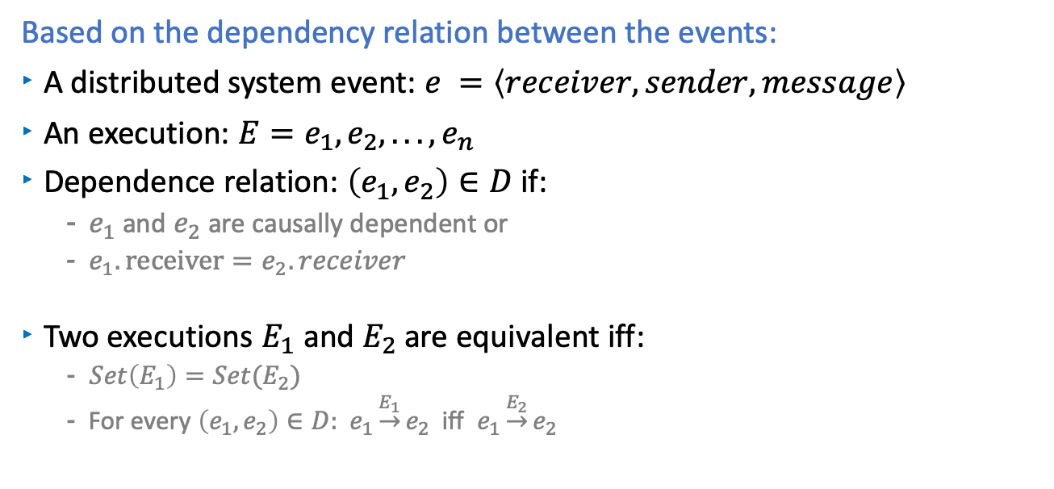
Partial order reduction for distributed systems
Based on the dependency relation between the events:
A distributed system event: $e =\left\langle receiver, sender, message\right\rangle$
An execution: $E=e_{1},e_{2}, . . . ,e_{n}$
Dependence relation: $\left(e_{1},e_{2}\right)∈D$ if:
$e_{1}$ and${ e}_{2}$ are causally dependent or
$e_{1}.receiver=e_{2}.receiver$
Two executions $E_{1}$ and $E_{2}$ are equivalent iff:
$Set\left(E_{1}\right)=Set(E_{2})$
For every $\left(e_{1},e_{2}\right)∈D:$ $e_{1}\underset{→}{E_{1}}e_{2}$ iff $e_{1}\underset{→}{E_{2}}e_{2}$

Slide 16


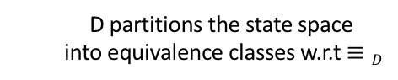
Partial order reduction for distributed systems
E
F
A
B
C
D
G
H
D partitions the state space
into equivalence classes w.r.t $≡D$
A B C D E F G H $≡D$ A B C E F G H D
A B C D E F G H $≢D$ B A C D E F G H

Slide 17
A complex example – Black-box POR is not sufficient
From “SAMC: Semantic-Aware Model Checking for Fast Discovery of Deep Bugs in Cloud Systems OSDI’14”

Slide 18
A complex example – Black-box POR is not sufficient
Too many events,
multiple crashes and reboots!
From “SAMC: Semantic-Aware Model Checking for Fast Discovery of Deep Bugs in Cloud Systems OSDI’14”

Slide 19
SAMC-Semantic Aware Model Checking¹
Existing approaches for reduction is not sufficient
Classical DPOR
Black box, exploits general properties of distributed systems
SAMC
White-box, exploits system specific semantic information
Use system semantics for state space reduction
Local message independence
Crash message independence
Crash recovery symmetry
Reboot synchronization symmetry
¹ SAMC: semantic-aware model checking for fast discovery of deep bugs in cloud systems, OSDI’14

Slide 20
Local message independence
Some messages sent to a node are concurrent
A
B
C
D
A
B
C
D
Black box DPOR
ABCD
ABDC
ACBD
…
4! reorderings
White box DPOR
ABCD
ABDC
BACD
BADC
4 reorderings
(with message processing semantics)

Slide 21
Local message independence
Increment:
if(pi(m, ls))
ls ++;
Discard:
if(pd(m, ls))
noop;
Constant:
if(pc(m, ls))
ls = Const;
Modify:
if(pm(m, ls))
ls = modify(m, ls)
m1 is independent of m2 if pd is true for any of m1 and m2
m1 is independent of m2 if pi (or pc) is true on both m1 and m2
m1 and m2 are dependent if pm is true on m1 and pd is not true on m2
(they modify the state in unique ways)

Slide 22
Crash message independence
Some messages and node crashes are concurrent
E.g. Crash of a node N is concurrent with messages A, B, C, D
Global impact:
if(pg(X, ls))
modify(ls);
sendMsg();
Local impact:
if(pg(X, ls))
modify(ls);
Black box DPOR
ABCDX
ABCXD
ABXCD
AXBCD
XABCD
White box DPOR
ABCDX

Slide 23
Crash recovery symmetry
Guide the model checker with the crash decisions
Some crashes lead to symmetrical recovery behaviors
In a 4-node system with FFFL, crashing the first and the second node may lead to the same behavior
Two recovery actions are symmetrical if they produce the same message and update the local state in the same way
Needs to extract recovery logic

Slide 24
Reboot synchronization symmetry
Guide the model checker with the reboot decisions
A reboot will not lead to a new scenario if the current state of the system is similar to the state it crashed
Needs to extract reboot synchronization predicates and corresponding actions

Slide 25
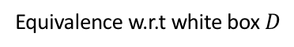
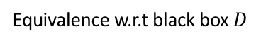
Partial order reduction for distributed systems
Semantic information provides coarser equivalence of executions:
Semantic info
Equivalence w.r.t black box $D$
Equivalence w.r.t white box $D$
. . . . . . . . .
. . . . . . . .
. . . . . . . . . . .
Systematic testing with pruning

Slide 26
Summary
Systematic testing suffers from state space explosion problem
Partial order reduction techniques reduce the state space
Generic notion of dependency – black box
Semantic knowledge for fine grained dependency – white box
Used for testing on Cassandra, Zookeeper, Hadoop
Reduction ratio between 37x to 166x in model checking Zookeeper
Some research questions:
What other system specific information can scale MC distributed systems?
How to extract the system specific information?
What other techniques can be used for an efficient testing?

Slide 27
How to detect bugs?
. . . . . . . . .
. . . . . . . .
. . . . . . . .
. . . . . . . . . . . . . . . . . . . . . . . . .
. . . . . . . .
. . . . . . . . . . .
. . . . . . . . . . .
Systematic testing - infeasible
Random testing (e.g. PCT, Jepsen)
Needs reduction techniques (e.g. SAMC, FlyMC)

